Slide 1


GenUI
From Design to Code. Instantly.
Zoho Developer Hackathon 2025

Slide 2

INNOVATION
Intelligent Design-to-Code Automation
GenUI is an intelligent design-to-code assistant that transforms visual UI designs into clean, production-ready code. It bridges the gap between designers and developers by automating the tedious translation process, eliminating manual inspection and repetitive styling work.
Built for modern development workflows, GenUI supports multiple input sources and generates code in your preferred format—whether that's Tailwind CSS, plain CSS, or ready-to-use React components.

Slide 3


The Developer's Daily Struggle
Manual Pixel Inspection
Screenshot Rebuilding
Tedious measurement of every spacing, font size, and element dimension using browser dev tools or design specs.
Recreating entire UI layouts from visual mockups without access to underlying design files or specifications.
Style Inconsistencies
Managing color values, spacing units, and typography across components without a centralized system.
Additional pain points include constant px to rem conversions and manually mapping design values to Tailwind utility classes—tasks that consume hours of valuable development time.

Slide 4





How GenUI Solves It
Extract
Normalize
Upload designs from screenshots, Figma, or design tools
Convert to standardized design tokens and style specifications
Convert
Use
Generate production-ready code in your preferred format
Copy, paste, and integrate directly into your projects
Save History
Store conversion history and reuse previous conversions
GenUI automates the entire design-to-code pipeline, transforming what used to take hours into a seamless, seconds-long process.

Slide 5
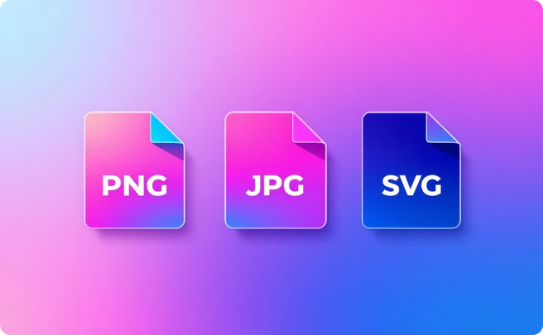

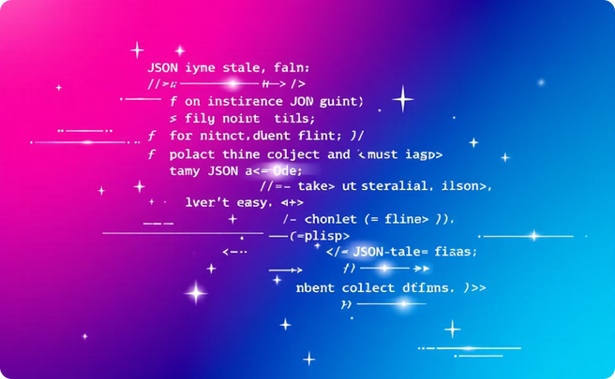
Flexible Input Sources
Image Files
Design Tools
Design Tokens
PNG, JPG, and SVG files for intelligent visual analysis.
Direct exports from Figma & Adobe XD with layer precision.
Standard JSON format for design systems.

Slide 6

FEATURES
Built for Modern Workflows
Multi-Source Extraction
Design Tokens
Multiple Output Formats
Smart Unit Conversion
Standardized intermediate format creates a single source of truth for your design system.
Seamlessly work with screenshots, design files, or token systems—whatever your team uses.
Generate Tailwind CSS, plain CSS, or complete JSX/React components ready for production.
Automatic responsive unit conversion ensures your UI scales perfectly across all devices.

Slide 7
Extraction Technologies
Image-Based Analysis
Upload UI screenshots for server-side visual analysis. Our AI extracts colors, spacing, typography, and layout structure—even from complex nested components and irregular designs.
Figma Integration
Our dedicated Figma plugin, available and published, allows you to extract styles directly from your Figma files as JSON. Simply paste this structured JSON output into GenUI for seamless conversion into your desired formats, preserving your design hierarchy with precision.
Design Token Standard
All extractions convert to a normalized intermediate JSON format. This creates a reusable, scalable single source of truth that works across projects and teams.

Slide 8

From Input to Output
01
Select your source type
Choose between image upload, Figma connection, or design token import
02
Preview extracted styles
Review detected colors, spacing, typography, and layout specifications
03
Choose output format
Select from Tailwind CSS, plain CSS, or JSX/React components
04
Convert and export
Generate production-ready code with one click and copy directly to your project

Slide 9
Technical Architecture
Core Stack
Security & APIs
Frontend: React-based interface for intuitive design uploads and style previews
Authentication: Zoho Catalyst Auth and Google OAuth for secure access
Backend: Zoho Catalyst serverless functions for scalable processing and conversion
Data Isolation: User-specific data storage with role-based permissions
Storage: Catalyst Data Store for conversion history and user preferences
Core APIs: analyzeImage, convertStyles, saveConversion, and getHistory endpoints
Extensions: Native Sigma and Figma plugins for seamless design tool integration
Deployed as a static frontend with Catalyst backend services, complemented by browser extensions for in-tool extraction.

Slide 10
The Impact
10x
100%
0
Faster Development
Style Consistency
Tedious Work
Reduce design-to-code time from hours to seconds
Eliminate manual errors with automated extraction
No more pixel-perfect manual measurements
Thank You
GenUI simplifies and accelerates design-to-code automation, empowering developers to focus on building great products instead of recreating designs.

